Slide 1
FEYNMAN GATE
A
P=A
Inputs |  | Outputs
A | B | P | Q
0 | 0 | 0 | 0
0 | 1 | 0 | 1
1 | 0 | 1 | 1
1 | 1 | 1 | 0
B
Q=A ⊕ B
Inputs |  |  | Outputs
A | B | C | P | Q | R
0 | 0 | 0 | 0 | 0 | 0
0 | 0 | 1 | 0 | 0 | 1
0 | 1 | 0 | 0 | 1 | 0
0 | 1 | 1 | 0 | 1 | 1
1 | 0 | 0 | 1 | 0 | 0
1 | 0 | 1 | 1 | 0 | 1
1 | 1 | 0 | 1 | 1 | 1
1 | 1 | 1 | 1 | 1 | 0
TOFFOLI GATE
A
P=A
B
Q=B
C
R=AB⊕C

Slide 2
Inputs |  |  | Outputs
A | B | C | P | Q | R
0 | 0 | 0 | 0 | 0 | 0
0 | 0 | 1 | 0 | 0 | 1
0 | 1 | 0 | 0 | 1 | 0
0 | 1 | 1 | 0 | 1 | 1
1 | 0 | 0 | 1 | 0 | 0
1 | 0 | 1 | 1 | 1 | 0
1 | 1 | 0 | 1 | 0 | 1
1 | 1 | 1 | 1 | 1 | 1
FREDKIN GATE
A
P=A
B
Q=A’B⊕AC
C
R=A’C⊕AB
Inputs |  |  | Outputs
A | B | C | P | Q | R
0 | 0 | 0 | 0 | 0 | 0
0 | 0 | 1 | 0 | 0 | 1
0 | 1 | 0 | 0 | 1 | 0
0 | 1 | 1 | 0 | 1 | 1
1 | 0 | 0 | 1 | 1 | 0
1 | 0 | 1 | 1 | 1 | 1
1 | 1 | 0 | 1 | 0 | 1
1 | 1 | 1 | 1 | 0 | 0
PERES GATE
A
P=A
B
Q=A⊕B
C
R=AB⊕C

Slide 3
REVERSIBLEGATE
I₁
REVERSIBLE GATE
O₁
A
P=A
I₂
O₂
I₃
O₃
B
Q=A⊕B
I₄
O₄
……
……
C
R=AB⊕C
I_{n}
O_{n}

Slide 4
Logic ‘0’ Propagation
Logic ‘1’ Propagation

Slide 5
Coulomb Repulsion
Input Logic ‘0’
Output Logic ‘1’

Slide 6
Literature Survey
Reversible Gates
Arithmetic and Logic Unit (ALU)
Division Unit

Slide 7
KMD Gate1
KMD Gate2
A
P=A
A
P=A
B
Q=A’C⊕AB’
B
Q=A’B’⊕AC
C
R=A’B⊕AC’
C
R=A’C’⊕AB
A
KMD Gate3
P=A⊕D
A
KMD Gate4
P=A
B
Q=B⊕C⊕D
B
Q=A’B⊕AC’
C
R=A⊕B⊕C
C
R=A’C⊕AB
D
S=A(B⊕ C)⊕BC⊕D
D
S=A’C⊕AB⊕D
E
T=BC’⊕E
Proposed KMD Gates

Slide 8
Peres Gate
R Gate
A
P=A
A
P=A⊕B
B
Q=A⊕B
B
Q=A
C
R=AB⊕C
C
R=AB⊕C’
TR Gate
URG Gate
A
P=A
A
P=AB⊕C
B
Q=A⊕B
B
Q=B
C
R=AB’⊕C
C
R=(A+B)⊕C
PPRG Gate
SAM Gate
A
P=A⊕B
A
P=A’
B
Q=AC+B’C’
B
Q=A’B⊕AC’
C
R=A’C+B’C’
C
R=A’C⊕AB

Slide 9
A
R1 Gate
P=A⊕C
A
TSG Gate
P=A
B
Q=B⊕C⊕AB⊕BC
B
Q=A’B’⊕B’
C
R=A⊕B⊕C
C
R=(A’C’⊕B’)⊕D
D
S=AB⊕BC⊕C⊕D
D
S=(A’C’⊕B’)D⊕(AB⊕C)
A
OTG Gate
P=A
A
PAOG Gate
P=A
B
Q=A⊕B
B
Q=A⊕B
C
R=A⊕B⊕D
C
R=AB⊕C
D
S=(A⊕B)D⊕(AB⊕C)
D
S=((A⊕B)⊕D)⊕(AB⊕C)
A
SMS Gate
P=A⊕C⊕D
A
BME Gate
P=A
B
Q=D⊕BC
B
Q=AB⊕C
C
R=C
C
R=AD⊕C
D
S=BC⊕C⊕B⊕D
D
S=A’B⊕C⊕D

Slide 10
A
MRG Gate
P=A
B
Q=A⊕B
C
R=A⊕B⊕C
D
S=(AB⊕D)⊕((A⊕B)⊕C)
A
UPPG Gate
P=A⊕B⊕D
B
Q=A⊕CD
C
R=A⊕(C+D)
A
HNG Gate
P=A
D
S=D
B
Q=B
C
R=(A⊕B)⊕C
D
S=(A⊕B)C⊕(AB⊕D)

Slide 11
RUG
A
P=AB+BC+CA
B
Q=AB+A’C’
C
R=B⊕C
RM
A
P=A⊕BC
B
Q=A’B+AC
C
R=A’C+AB

Slide 12
A
KMD Gate4 (Adder)
G
A
KMD Gate3 (Half Adder)
A⊕B
B
G
B
G
C
A⊕B⊕C
0
AB
0
A(B⊕ C)⊕BC
B
G
0
G
Sel
KMD Gate3 (Mux)
G
A
KMD Gate3 (XOR)
A⊕B
A
G
0
G
B
0
G
Sel’B⊕SelA
0
G
B
G
KMD Gate1 (Inverter)
KMD Gate2 (AND)
A
P=G
A
P=G
B=1
Q=A’
B
Q=G
C=1
R=A’
C=1
R=AB

Slide 13
KMD Gate1 (OR)
A
P=G
B
Q=G
C=0
R=A’B⊕A
CLK
KMD Gate3
(D LATCH)
P=CLK
D
Q=G
R=CLK’.Q⊕CLK.D
0
S=Q

Slide 14
CLK
KMD Gate3
(D LATCH)
CLK
HOLD
KMD Gate3
(MUX)
HOLD
G
G
Q_{i}⁺
Q_{i}
0
0
G
SP
KMD Gate3
(MUX)
SP
SI
G
PI
SP’PI⊕SP.SI
0
G
CLK
PIPO Multifunctional Register
CLK
HOLD
HOLD
SP
SP
Multi-Functional Register
SI
Q_{i}
PI
Q_{i}⁺

Slide 15
PIPO Register
KMD Gate3
(D LATCH)
P=CLK
KMD Gate3
(D LATCH)
P=CLK
KMD Gate3
(D LATCH)
P=CLK
CLK
D₁
Q=G
D₂
Q=G
D_{n}
Q=G
0
0
0
S=Q₁
S=Q₂
S=Q_{n}

Slide 16
PARALLEL ADDER
A₁
P=G
P=G
A_{n}
P=G
KMD Gate4
(Adder)
A₂
KMD Gate4
(Adder)
KMD Gate4
(Adder)
Q=G
Q=G
B₁
B₂
B_{n}
Q=G
R=S₁
R=S₂
C_{n}
C_{in}
R=S_{n}
0
S=C₁
S=C₂
0
0
S=C_{n}
0
T=G
T=G
0
T=G
0

Slide 17
Vertical
Line
A
P
Horizontal
Line
B
Q
A
P
A
P
B
V
If A then
V(B) else B
B
V⁺
If A then
V⁺(B) else B

Slide 18
NOT Property of V and V⁺ gates
0
V
v
v
V
1
0
V⁺
w
w
V⁺
1
1
V
V
V
V
0
1
V ⁺
W
W
V ⁺
0
IDENTITY Property of V and V⁺ gates
0
V
v
v
V⁺
0
1
V
V
V
V⁺
1

Slide 19
A
P
B
Q
A
V
V
P
B
Q

Slide 20
CNOT
A
P
A
P
B
Q
B
V
V⁺
Q

Slide 21
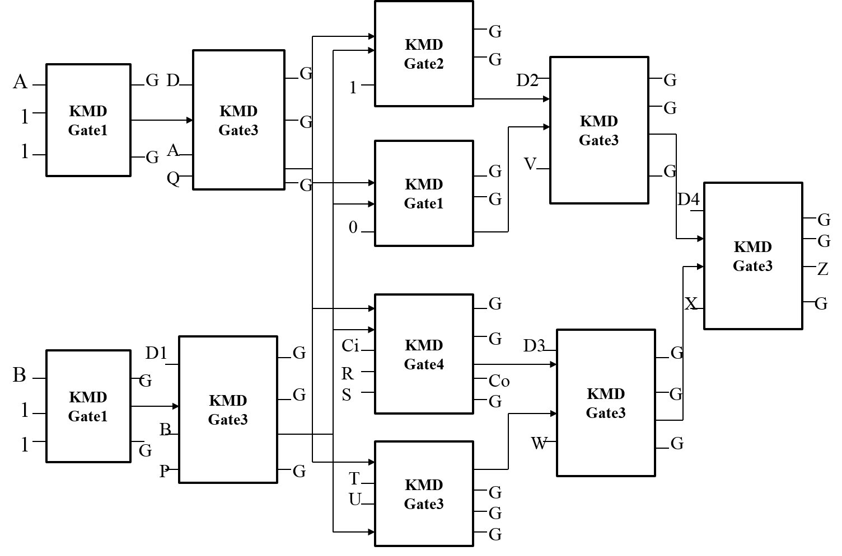
(Result)

Slide 22
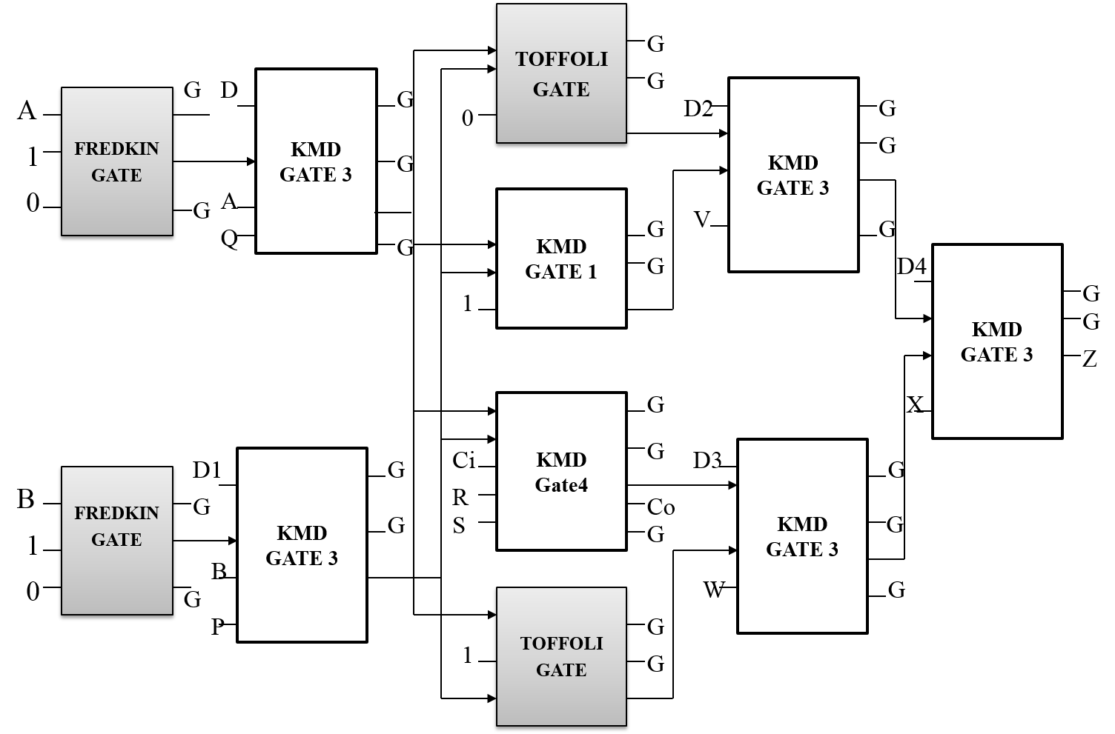
(Result)
G
G

Slide 23
KMD gate2
G
G
S_{OP}
KMD gate3
A
KMD gate1
G
S_{A}
KMD gate3
G
G
1
G
1
G
1
A
KMD gate1
G
G
G
S_{OP}
KMD gate3
G
0
G
Z (Result)
G
G
KMD gate4
G
S_{OP}
KMD gate3
C_{in}
S_{B}
KMD gate3
0
B
KMD gate1
G
C_{O}
G
G
1
1
B
G
KMD gate3
G
G

Slide 24
KMD gate2
G
G
S_{OP}
KMD gate3
A
KMD gate1
G
S_{A}
KMD gate3
G
G
1
G
1
G
1
A
KMD gate1
G
G
G
S_{OP}
KMD gate3
G
0
G
Z (Result)
G
G
KMD gate4
G
S_{OP}
KMD gate3
C_{in}
S_{B}
KMD gate3
0
B
KMD gate1
G
C_{O}
G
G
1
1
B
G
KMD gate3
G
G

Slide 25
Toffoli Gate (AND)
G
G
KMD Gate3 (MUX)
G
S_{A}
KMD Gate3 (MUX)
G
S_{OP}
G
A
Fredkin Gate (NOT)
0
G
1
G
0
A
KMD Gate1 (OR)
G
G
G
S_{OP}
KMD Gate3 (MUX)
G
0
G
Z (Result)
G
G
KMD Gate4 (ADDER)
G
S_{OP}
KMD Gate3 (MUX)
C_{in}
S_{B}
KMD Gate3 (MUX)
0
B
Fredkin Gate (NOT)
G
C_{O}
G
G
G
1
0
B
G
G
Toffoli Gate (XOR)
1
G

Slide 26
KMD gate2
A₀
G₁
B₀
G₂
P₀
1
KMD gate2
P₁
A₀
G₃
KMD gate3
B₁
G₄
G₉
A
KMD Gate4
A
A₀B₁
A₀A₁B₀B₁
B
A’B⊕AC’
1
0
C
A⊕B⊕C
G₁₀
D
A(B⊕ C)⊕BC⊕D
KMD gate2
A₁
G₅
E
BC’⊕E
P₂
B₀
G₆
KMD gate3
A₁B₀
G₁₁
1
0
P₃
KMD gate2
G₁₂
A₁
G₇
B₁
G₈
A₁B₁
1

Slide 27
FREDKIN GATE
A₀
G₁
B₀
G₂
P₀
0
FREDKIN GATE
A
P=A
FREDKIN GATE
P₁
A₀
G₃
KMD gate3
B
Q=A’B+AC
B₁
G₄
G₉
0
R=AB+A’C
A₀B₁
A₀A₁B₀B₁
0
0
G₁₀
FREDKIN GATE
A₁
G₅
P₂
B₀
G₆
KMD gate3
A₁B₀
G₁₁
0
0
P₃
FREDKIN GATE
G₁₂
A₁
G₇
B₁
G₈
A₁B₁
0

Slide 28
B_{(n/2):(n-1)}
A_{(n/2):(n-1)}
B_{(n/2):(n-1)}
A_{0:(n/2-1)}
B_{0:(n/2-1)}
A_{(n/2):(n-1)}
B_{0:(n/2-1)}
A_{0:(n/2-1)}
n/2 × n/2 VM₄
n/2 × n/2 VM₃
n/2 × n/2 VM₂
n/2 × n/2 VM₁
n-bit Ripple Carry adder
………….
(n/2-1)-bit RCA
n-bit Ripple Carry Adder
S_{(3n/2+1)+(2n-1)}
S_{(n/2+1)+(3n/2)}
S_{n/2}
S_{0:(n/2-1)}

Slide 29
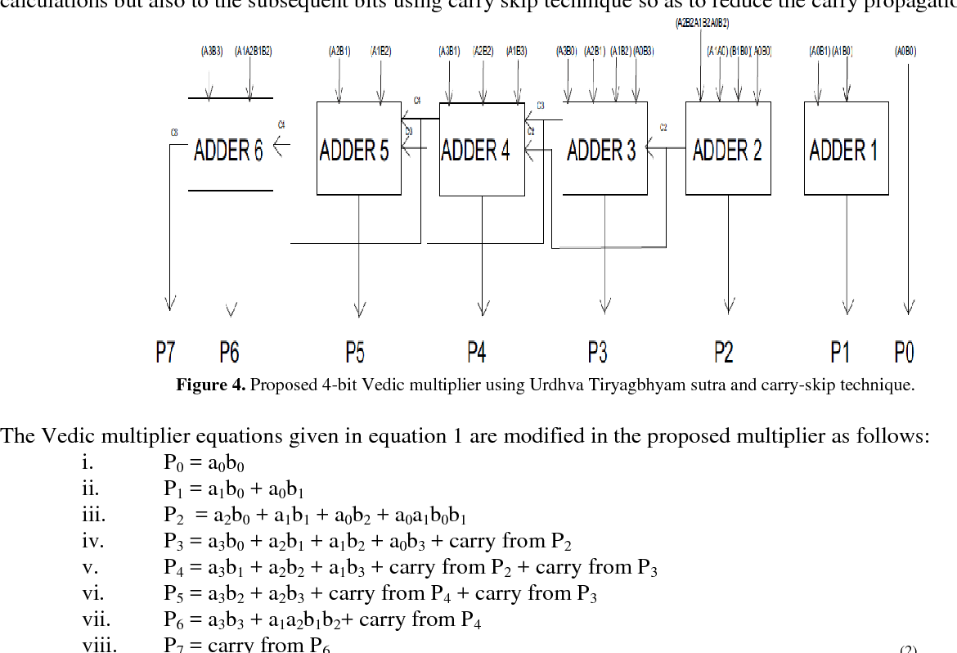
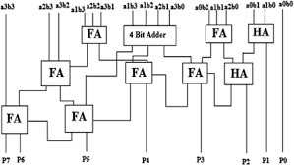

Slide 30
A₃
A₁
A₃
A₂
A₃
A₀
A₁
A₂
A₃
A₀
A₁
B₃
KMD Gate2
B₃
KMD Gate2
B₁
KMD Gate2
A₀
A₂
A₁
B₃
KMD Gate2
B₂
KMD Gate2
B₃
KMD Gate2
B₂
A₂
KMD Gate2
B₁
KMD Gate2
B₀
KMD Gate2
B₁
KMD Gate2
B₀
KMD Gate2
1
1
1
B₂
KMD Gate2
B₀
KMD Gate2
B₁
KMD Gate2
1
1
B₂
KMD Gate2
1
1
1
1
1
1
1
1
1
1
A₀
KMD Gate3
KMD Gate3
P₀
B₀
KMD Gate2
KMD Gate3
1
P₁
KMD Gate4
KMD Gate3
KMD Gate4
KMD Gate4
KMD Gate3
KMD Gate4
KMD Gate3
KMD Gate3
KMD Gate3
KMD Gate4
KMD Gate4
KMD Gate4
KMD Gate3
P₇
P₆
P₅
P₄
P₃
P₂

Slide 31
A₀
KMD Gate2
(AND)
P₀
B₀
1
A₁
KMD Gate2
(AND)
B₀
P₁
1
KMD Gate3
(Half Adder)
A₀
KMD Gate2
(AND)
B₁
1
A₁
KMD Gate3
(Half Adder)
P₂
KMD Gate2
(AND)
B₁
1
A₂
KMD Gate2
(AND)
KMD Gate4
(Full Adder)
B₀
1
A₀
KMD Gate2
(AND)
B₂
1
KMD Gate4
(Full Adder)
P₃
A₃
KMD Gate2
(AND)
B₀
1
KMD Gate3
(Half Adder)
KMD Gate3
(Half Adder)
A₂
KMD Gate2
(AND)
B₁
1
KMD Gate4
(Full Adder)
A₃
KMD Gate2
(AND)
B₁
1
A₁
KMD Gate2
(AND)
B₂
1
KMD Gate3
(Half Adder)
A₀
KMD Gate4
(Full Adder)
P₄
KMD Gate2
(AND)
B₃
1
A₁
KMD Gate2
(AND)
KMD Gate4
(Full Adder)
B₃
1
A₂
KMD Gate2
(AND)
KMD Gate4
(Full Adder)
P₅
B₂
1
A₃
KMD Gate2
(AND)
B₂
1
KMD Gate3
(Half Adder)
KMD Gate3
(Half Adder)
KMD Gate3
(Half Adder)
P₆
A₂
KMD Gate2
(AND)
B₃
1
KMD Gate4
(Full Adder)
A₃
KMD Gate2
(AND)
KMD Gate3
(Half Adder)
P₇
B₃
1

Slide 32
A₀
KMD Gate2
(AND)
P₀
B₀
1
A₁
KMD Gate2
(AND)
B₀
P₁
1
KMD Gate3
(Half Adder)
A₀
KMD Gate2
(AND)
B₁
1
A₁
KMD Gate3
(Half Adder)
P₂
KMD Gate2
(AND)
B₁
1
A₂
KMD Gate2
(AND)
KMD Gate4
(Full Adder)
B₀
1
A₀
KMD Gate2
(AND)
B₂
1
KMD Gate4
(Full Adder)
P₃
A₃
KMD Gate2
(AND)
B₀
1
KMD Gate3
(Half Adder)
KMD Gate3
(Half Adder)
A₂
KMD Gate2
(AND)
B₁
1
KMD Gate4
(Full Adder)
A₃
KMD Gate2
(AND)
B₁
1
A₁
KMD Gate2
(AND)
B₂
1
KMD Gate3
(Half Adder)
A₀
KMD Gate4
(Full Adder)
P₄
KMD Gate2
(AND)
B₃
1
A₁
KMD Gate2
(AND)
KMD Gate4
(Full Adder)
B₃
1
A₂
KMD Gate2
(AND)
KMD Gate4
(Full Adder)
P₅
B₂
1
A₃
KMD Gate2
(AND)
B₂
1
KMD Gate3
(Half Adder)
KMD Gate3
(Half Adder)
KMD Gate3
(Half Adder)
P₆
A₂
KMD Gate2
(AND)
B₃
1
KMD Gate4
(Full Adder)
A₃
KMD Gate2
(AND)
KMD Gate3
(Half Adder)
P₇
B₃
1

Slide 33
REVERSIBLE LOGIC
Reversible Gates
Performance Metrics
Technology & Tools Used
Basic / Conventional Gates
Special / New Gates
Quantum Cost
Constant Inputs
Garbage Outputs
Logical Calculations
Number of Gates
Total Cost
Area
Number of Cells
Number of Cycles
Technology
Transistor Level
Quantum Circuits
Tools
HDL – Xilinx
QCA – QCADesigner / HDLQ
QC – RCViewer / QCViewer
Feynman
Fredkin
Toffoli
Peres
Feynman Double (F2G)
Reversible Gates
Parity Preserving
TR
HNG
PFAG
TSG
PAOG
BJN
BME
SAM
MPG
MRG
R-CQCA
BHX
BVPPG
URG
MIG
BHPX
P2PG
ZPLG
NFT
RC-I, RC-II
TVG
PRUG
RQCA
PPPG
FTRA
SMS
DKG
RUG
RM
UPPG
RFS
RR

Slide 34
ALU
ARITHMETIC OPERATIONS
LOGICAL OPERATIONS
NOT
XOR
AND
OR
NAND
NOR
XNOR
COPY
TRANSFER
Addition
Subtraction (1’s and 2’s)
Increment
Transfer
Decrement
Add with carry
Constants (0 or 1)

Slide 35
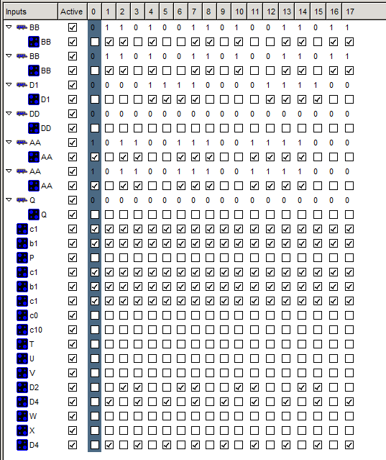
Vector Table for Simulation

Slide 36
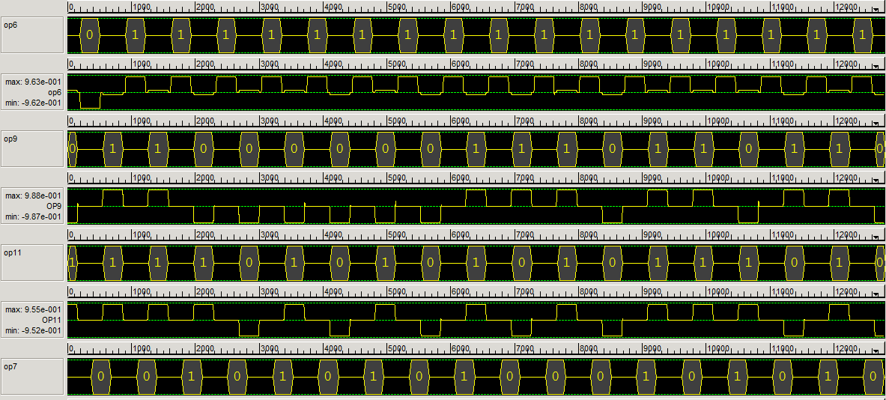
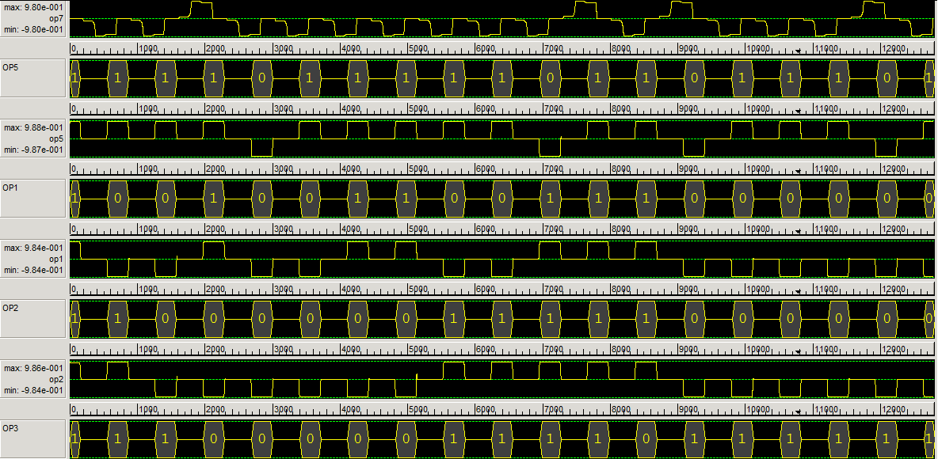
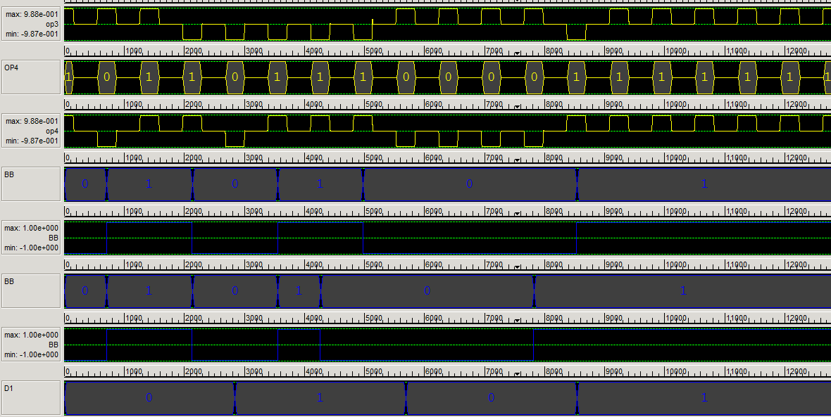
SIMULATION OUTPUT

Slide 37
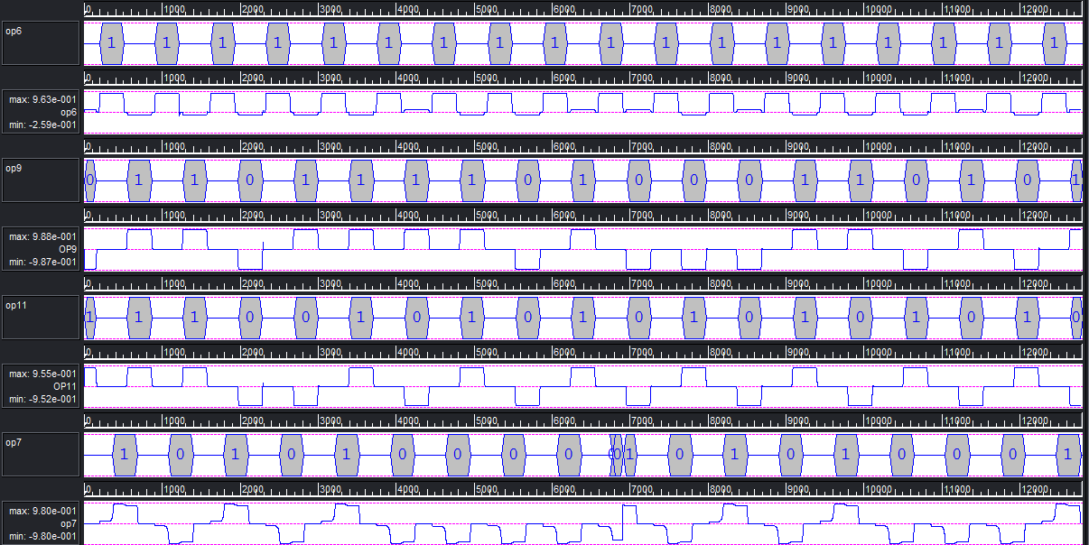
INPUT
0000
0011
0101
1000
1011
1110
OUTPUT

Slide 38
XOR
A
P=A⊕B
0
G
0
G
B
G

Slide 39
Half Adder
A
P=A⊕B
B
G
0
Q=AB
B
G

Slide 40
D Latch
CLK
P=CLK
D
G
Q
Q=CLK’.Q⊕CLK.D
0
G

Slide 41
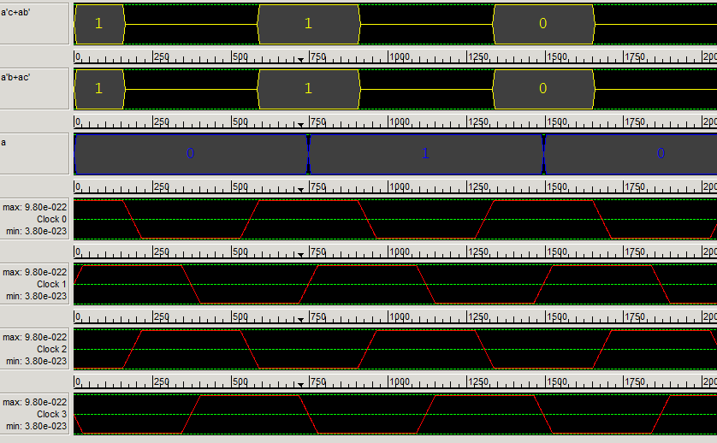
Inverter Output

Slide 42
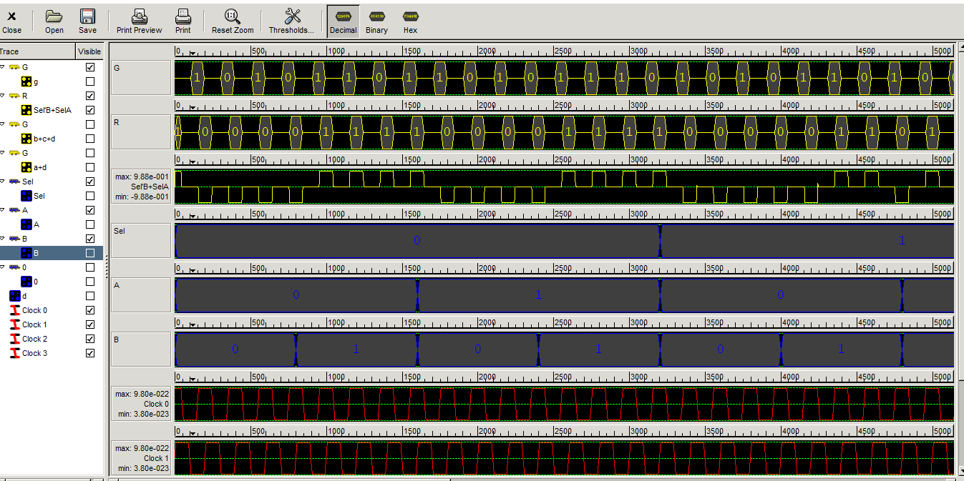
Mux Output

Slide 43
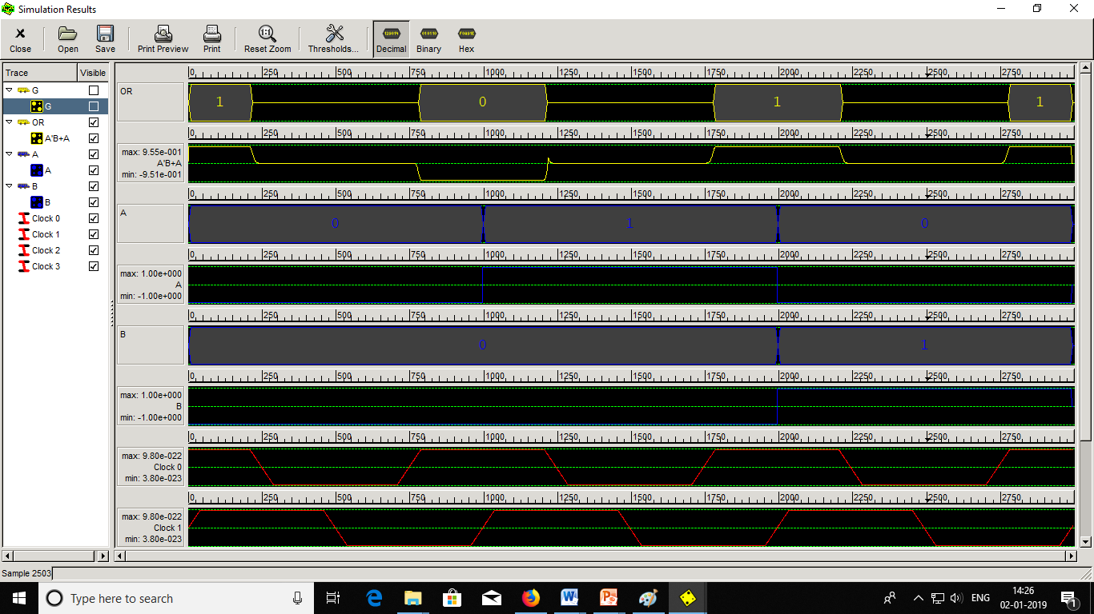
OR Output

Slide 44
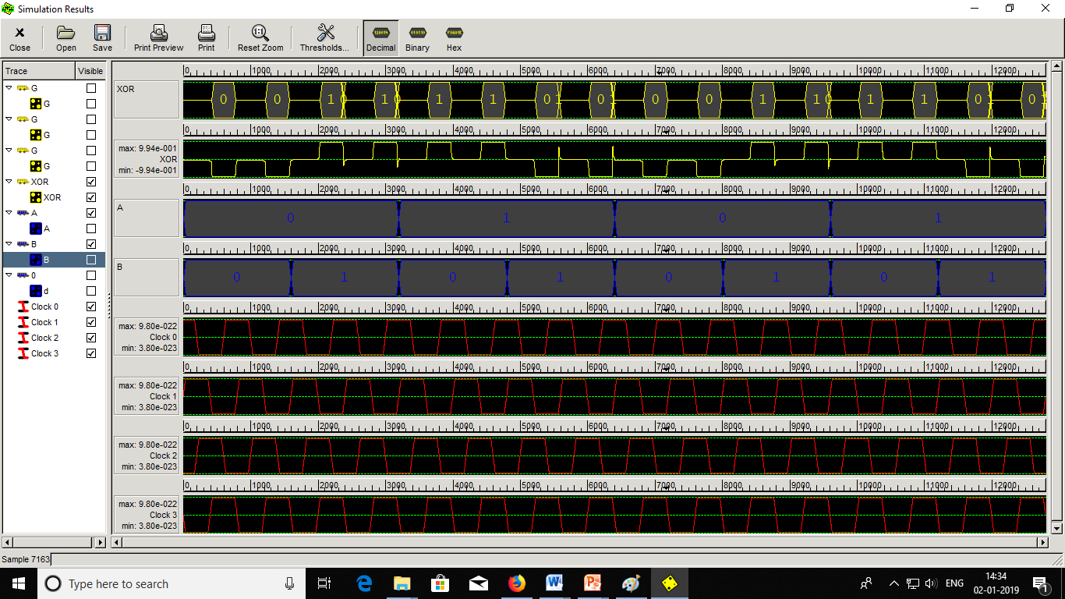
XOR Output

Slide 46
Reversible Logic
Design
Synthesis
Testing
Debashis De
Quantum Circuits
V and V+ gates
BDD Algorithm
Stuck at faults (Single/Multiple)
Missing gate fault
Missing control fault
H.Thapliyal
Adder
Mux/Demux
Encoder/Decoder
Code Converter
Flip-Flops
Shift Registers
Counters
Memories
Landauer
Bennett
Feynman
Fredkin
Peres
Morrison M
M. Haghparast
Jayashree H V
Neeraj Kumar Misra
Bibhash Sen
Rakshith Saligram
Hasan Babu
ALU
Multiplier
Division Unit
A.V. Anantha Lakshmi
Selim Al Mamun

Slide 47
Reversible Logic
Reversibility
Universality
Fault-Tolerance
Reversible Gate
Quantum Cost
Garbage Output
Constant Input

Slide 48
STUDIES ON PERFORMANCE OF REVERSIBLE LOGIC GATES AND CIRCUITS
ALU
FP Division
Vedic Multiplier
Modules
Inverter
Logic gates (NOT, OR, AND, XOR)
Adder
Multiplexer
Outcome
10 – Arithmetic
8 – Logical
Modules
Multiplexer
Adder
Multi-functional Register
Control Unit
Outcome
N-bit Floating point division
Modules
AND Logic
Adders
Ripple Carry Adder
2×2 Multiplier
Outcome
2×2 Multiplier
n×n Multiplier Structure
ALU
FP Division
Vedic Multiplier
Simulation
Quantum Cellular Automata
Quantum Circuit
Measures
Quantum Cost
Constant Inputs
Garbage Output
Logical Calculations

Slide 49
Studies on Reversible Logic Based Gates and Circuits for Arithmetic Operations
Proposed New Gates
ALU
FP Division
Vedic Multiplier
Gates
KMD Gate1
KMD Gate2
KMD Gate3
KMD Gate4
Outcome
Average NoG 1.76, QC 18.23
5 logical functions per Gate
Reduced Area
Modules
Logic gates (NOT, OR, AND, XOR)
Adder
Multiplexer
Outcome
10 Arithmetic, 8 Logical Operations
Integrated Architecture
Improved Performance
Modules
Multiplexer
Adder
Multi-functional Register
Control Unit
Outcome
Performance Metrics Linear with ‘n’
Higher Order Designs has Better Performance
Modules
AND Logic
Adders
Ripple Carry Adder
2×2 Multiplier
Outcome
Parity Preserving VM
Improved Performance
Simulation
Quantum Cellular Automata
Quantum Circuit
Performance Metrics
Quantum Cost
Constant Inputs
Garbage Output
Number of Gates
Logical Calculations

Slide 50
LITERATURE REVIEW
Combinational Circuits
Sequential Circuits
System Level Circuits
Adder / Subtractor
Comparators
Multiplexer / Demultiplexer
Code Converters
Encoder / Decoder
Flip-Flops
Counters
Shift Registers
Pseudo Random Bit Sequence
Memory (RAM / ROM)
Arithmetic and Logic Unit (ALU)
Floating Point Division Unit
Vedic Multiplier
Xue et al. 2014
Bibhash et al. 2014
Jadav & Debashis 2016
Gopi & Anusudha 2017
Arabani et al. 2018
Neeraj et al. 2018
Morrison et al. 2011
Thapliyal & Ranganathan 2013
Abbas & Hamidreza 2016
Shraddha et al. 2016
Abdullah et al. 2018
Tamoghna et al. 2018
Saligram & Rakshith 2013
Faraz & Majid 2012
Trailokya et al. 2016
Hafiz & Solaiman 2016
Armin & Monireh 2017
Anantha & Sudha 2017
Ashvin et al. 2018

Slide 51
This cell is included, because
its Centre is within radius of the Cell Ci
Cell Ci
Radius Effect
This cell is included, because
it is within the radius of the Cell Ci
This cell is included, because
It is not within the radius of the Cell Ci

